Slide 1
McCulloch Pitts Neuron - Perceptron
Prakash P VIT , Chennai

Slide 2
Road Map
McCulloch Pitts Neuron
Perceptron

Slide 3
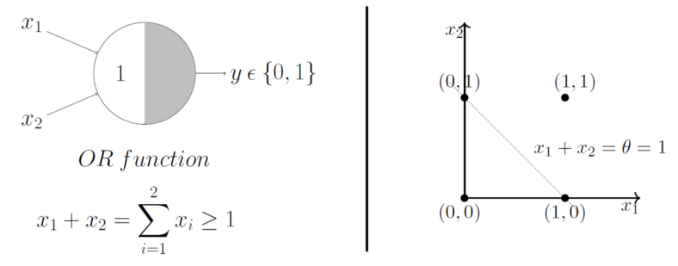
Geometric Interpretation of a MP Neuron
Already discussed that the OR function’s thresholding parameter theta is 1
Now plotting them on a 2D graph and making use of the OR function’s aggregation equation
x₁ + x₂ ≥ 1 using which we can draw the decision boundary as shown in the graph
Graphically show that all those inputs whose output when passed through the OR function M-P neuron lie ON or ABOVE that line and all the input points that lie BELOW that line are going to output 0
The M-P neuron just learnt a linear decision boundary ☺
The M-P neuron is splitting the input sets into two classes — positive and negative. Positive ones (which output 1) are those that lie ON or ABOVE the decision boundary and negative ones (which output 0) are those that lie BELOW the decision boundary

Slide 4
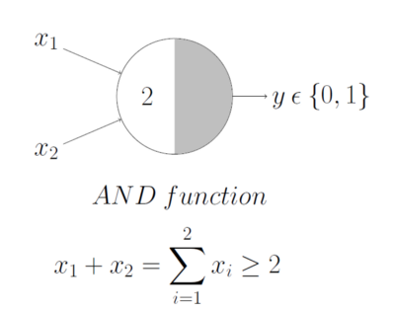

Geometric Interpretation of a MP Neuron

Slide 5
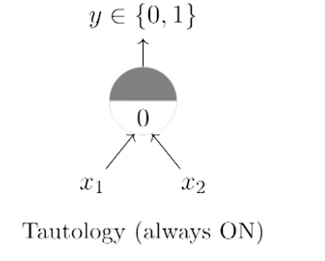
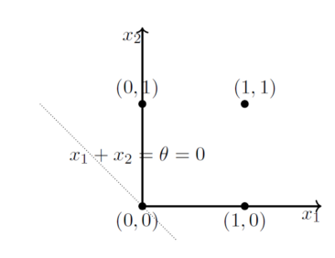
Geometric Interpretation of a MP Neuron
If you have more than 2 inputs?

Slide 6
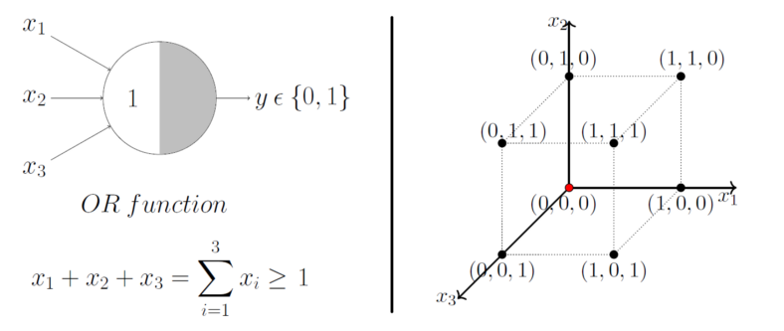

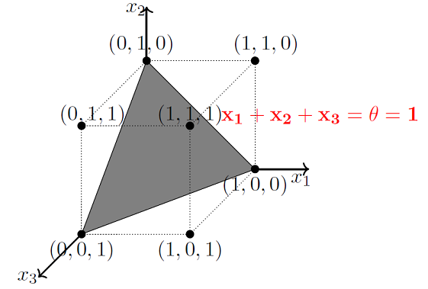
Geometric Interpretation of a MP Neuron
Lets just generalize this by looking at a 3 input OR function M-P unit. In this case, the possible inputs are 8 points — (0,0,0), (0,0,1), (0,1,0), (1,0,0), (1,0,1)……

Slide 7
Limitations of a MP Neuron
What about non-boolean (say, real) inputs?
Do we always need to hand code the threshold?
Are all inputs equal? What if we want to assign more importance to some inputs?
What about functions which are not linearly separable?
XOR function.

Slide 8
Classical Perceptron
Frank Rosenblatt, an American psychologist, proposed the classical perception model, the mighty artificial neuron, in 1958
It is more generalized computational model than the McCulloch-Pitts neuron where weights and thresholds can be learnt over time
A more general computational model than McCulloch–Pitts neurons
Main differences with MP Neuron:
Introduction of numerical weights for inputs and a mechanism for learning
these weights
Inputs are no longer limited to boolean values
Refined and carefully analysed by Minsky and Papert (1969) - their model is referred to as the perceptron model

Slide 9
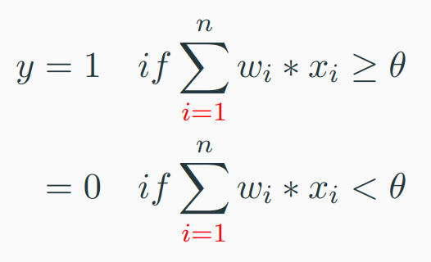
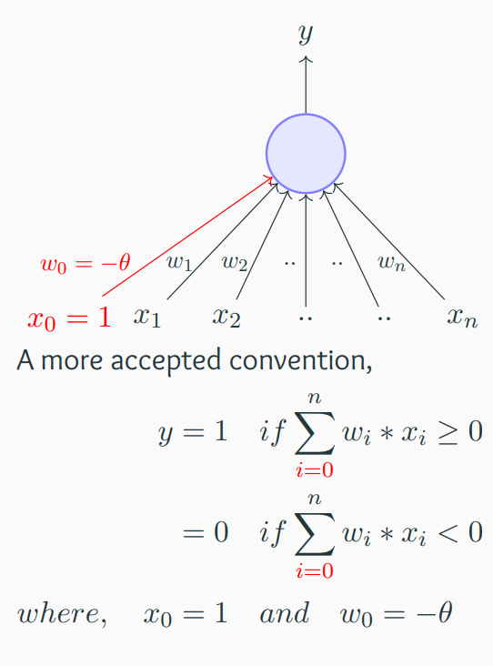
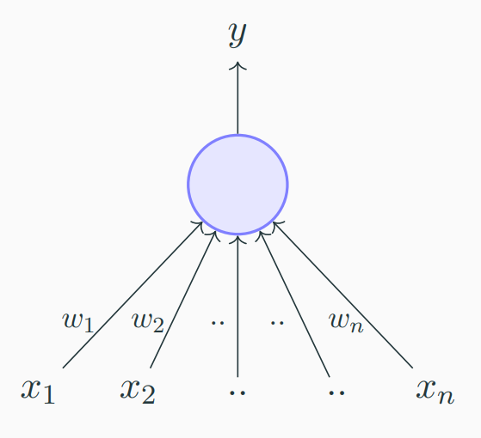
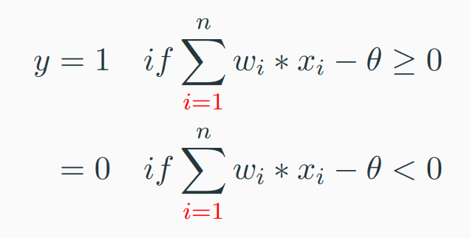
Perceptron Model

Slide 10
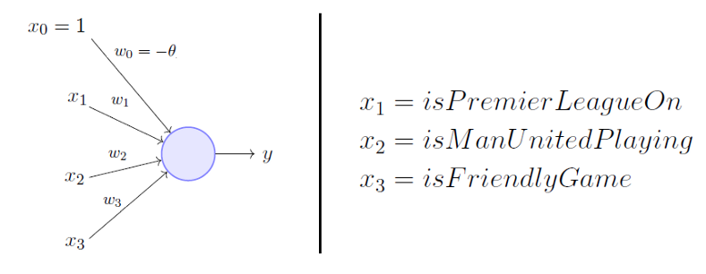
Perceptron Model
Consider the task of predicting whether I would watch a random game of football on TV or not
Here, w₀ is called the bias because it represents
the prior
A football freak may have a very low threshold and may watch any football game irrespective of the league, club or importance of the game [theta = 0]
The point is, the weights and the bias will depend on the data ( viewing history in this case)
Based on the data, if needed the model may have to give a lot of importance (high weight) to the isManUnitedPlaying input and penalize the weights of other inputs
A selective viewer like me may only watch a football game that is a premier league game, featuring Man United game and is not friendly [theta = 2]

Slide 11
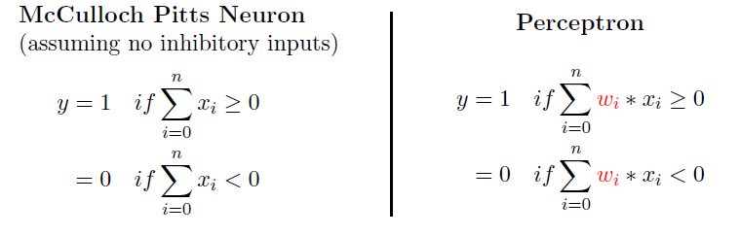
Perceptron vs McCulloch-Pitts Neuron
From the equations, it is clear that even a perceptron separates the input space into two halves, positive and negative
All the inputs that produce an output 1 lie on one side (positive half space) and all the inputs that produce an output 0 lie on the other side (negative half space)
A single perceptron can only be used to implement linearly separable functions, just like the M-P neuron
Then what is the difference? Why do we claim that the perceptron is an updated version of an M-P neuron?
The weights, including the threshold can be learned and the inputs can be real values

Slide 12
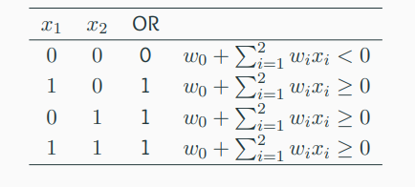
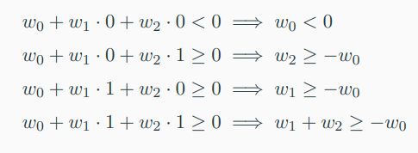
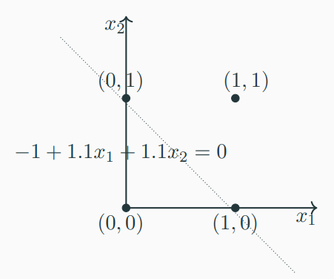
Boolean Functions Using Perceptron
One possible solution to this set of inequalities is w₀ = −1, w₁ = 1.1, , w₂ = 1.1
you can try it out for AND function

Slide 13
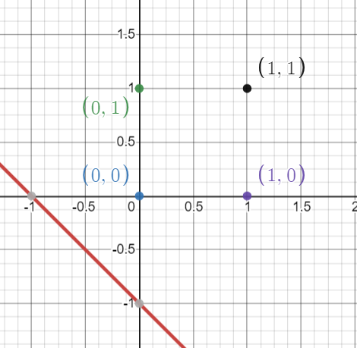
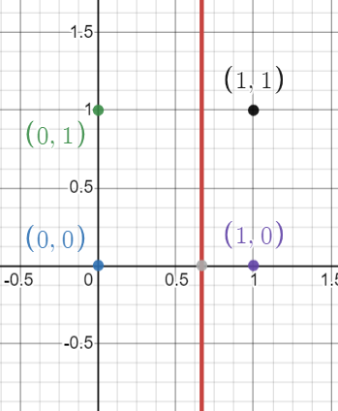
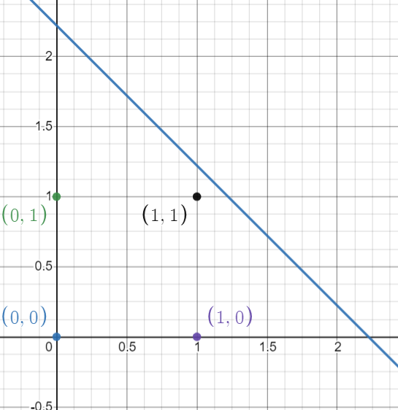
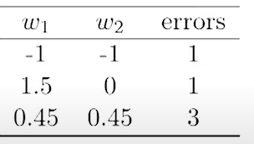
Errors and Error Surfaces
Let us fix the threshold (−w₀ = 1) and try different values of w1, w2
Say, w₁ = −1, w₂ = −1
w1 = 1.5, w2 = 0
w1 = .45, w2 = 0.45
We are interested in finding an algorithm which finds the values of w1, w2 which minimize this error ☺ ☺

Slide 14
References
https://towardsdatascience.com/mcculloch-pitts-model-5fdf65ac5dd1
https://www.cse.iitm.ac.in/~miteshk/CS6910.html#schedule

Slide 15
Thanks

